Slide 1
Users
MySQL allows us to specify which user account can connect to a database server. The user account details in MySQL contains two information – username and host from which the user is trying to connect in the format username@host-name.
If the admin user is connecting through localhost then the user account will be admin@localhost.
MySQL stores the user account in the user grant table of the mysql database.

Slide 2
Users
The CREATE USER statement in MySQL allows us to create new MySQL accounts or in other words, the CREATE USER statement is used to create a database account that allows the user to log into the MySQL database.
Syntax: The syntax for the CREATE USER statement in MySQL is:
CREATE USER user_account IDENTIFIED BY password;
Parameters used:
user_account: It is the name that the user wants to give to the database account.
The user_account should be in the format ‘username’@’hostname’
password: It is the password used to assign to the user_account.
The password is specified in the IDENTIFIED BY clause.

Slide 3
Users - Examples
CREATE USER ‘gfguser1@localhost’ IDENTIFIED BY ‘abcd’;
(don’t forget the quotes around strings)
CREATE USER
gfguser2@localhost IDENTIFIED BY efgh,
gfguser3'@'localhost' IDENTIFIED BY uvxy;
CREATE USER gfguser2@% IDENTIFIED BY efgh
Viewing permissions of an User Account:
SHOW GRANTS FOR user-account

Slide 4
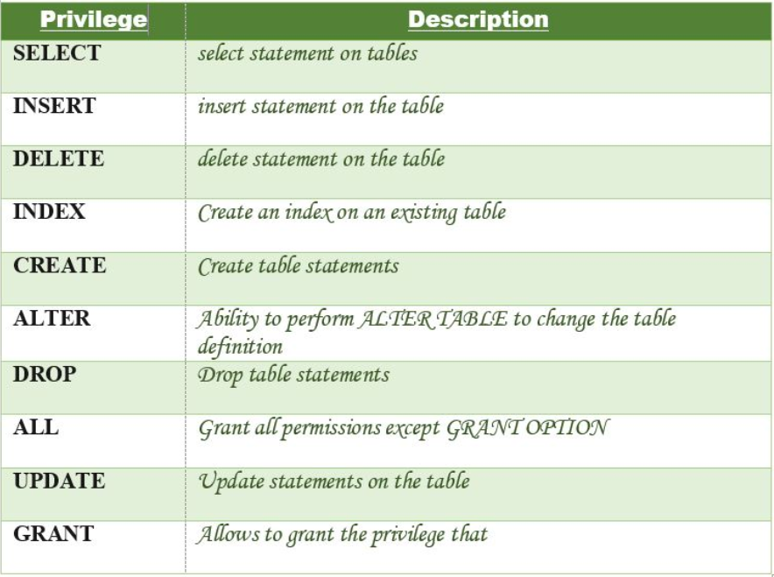
In MySQL Privileges can be one of the following

Slide 5
Granting Privileges
Create User Statement only creates a new user but does not grant any privileges to the user account. Therefore to grant privileges to a user account, the GRANT statement is used.
Syntax:
GRANT privileges_names ON object TO user;
Parameters Used:
privileges_name: These are the access rights or privileges granted to the user.
object:It is the name of the database object to which permissions are being granted. In the case of granting privileges on a table, this would be the table name.
user:It is the name of the user to whom the privileges would be granted

Slide 6
Granting Privileges
Granting one/more than one Privilege to a User in a Table:
GRANT SELECT ON Users TO 'Amit'@'localhost;
GRANT SELECT, INSERT, DELETE, UPDATE ON Users TO 'Amit'@'localhost;
Granting All the Privilege to a User in a Table:
GRANT ALL ON Users TO 'Amit'@'localhost;
Granting a Privilege to all Users in a Table:
GRANT SELECT ON Users TO '*'@'localhost;

Slide 7
Revoking Privileges
The Revoke statement is used to revoke some /all of the privileges which have been granted to a user in the past
REVOKE privileges ON object FROM user;
Parameters Used:
object:It is the name of the database object from which permissions are being revoked. In the case of revoking privileges from a table, this would be the table name.
user:It is the name of the user from whom the privileges are being revoked.

Slide 8
Revoking Privileges
Revoking one/more than one Privilege to a User in a Table:
REVOKE SELECT ON Users FROM 'Amit'@'localhost;
REVOKE SELECT, INSERT, DELETE, UPDATE ON Users FROM 'Amit'@'localhost;
Revoking All the Privilege to a User in a Table:
REVOKE ALL ON Users FROM 'Amit'@'localhost;
Revoking a Privilege to all Users in a Table:
REVOKE SELECT ON Users FROM '*'@'localhost;

